Slide 1

RESORT ANALYSIS

Slide 2

RESORT ANALYSIS RESORT ANALYSIS
Designed and Presented By
Mariam Erica John

Slide 3
INTRODUCTION
This Power BI report offers an in-depth analysis of resort booking data spanning from mid-2015 through 2017, focusing on critical metrics like booking volumes, seasonal demand fluctuations, and customer preferences. It highlights patterns in peak booking months, such as the increased demand in August, along with insights into guest demographics and reservation adjustments. By examining customer types and preferences, including special requests and reservation changes, this report provides a data-driven foundation for improving customer engagement, and optimizing operational strategies in the hospitality sector.

Slide 4
We are provided booking details of a resort for the years 2015 to 2017.
Excel file includes the details of:
Excel file includes the details of:
DATASET DETAILS
Hotel type
Lead time
Age category
Country
Market segment
Deposit type
Customer type

Slide 5
Expected outcome after this analysis?
Increased revenue by focusing on high-demand segments.
Reduced cancellations through better reservation management.
Enhanced customer loyalty by addressing frequent special requests

Slide 6
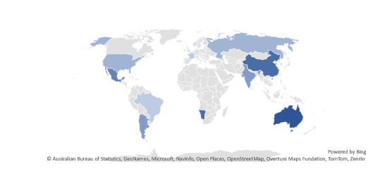
Mock-up Dashboard
118.99k
Total Bookings
102.01
ADR
Filter by Year
Filter by Year
Filter by Region
32K
Total Cancellation
104.07
Average Lead Time

Slide 7
This report include the following features:
RESORT
RESERVATIONS
OVERVIEW
Monthly ADR and Booking Volume
Lead Time by Region
Length of Stay by Market Segment
Room Type Distribution
Total Reservation by Month and Year
Booking Changes by Room Type
Cancellation by Market Segment
Stays in Week Nights and Stays in Weekend Nights by Hotel
Deposit Type Distribution
Total Reservation and Total Cancellation by Hotel
Total Reservations by Month
Booking Distribution by Hotel Type
Market Segment Distribution
Region Distribution
Booking Over Time
CUSTOMERS
THE REPORT CAN BE FILTERED ON THE BASIS OF:
Customer Type Distribution
Age Composition by Customer Type
Age Group Distribution
Month
Year
Region

Slide 8


